Slide 1
Global Economic and Demographic Trends Analysis
Reinforcement project - Excel, SQL, Statistics & Power BI
Prabin P
Data Analysis & Data Science

Slide 2
Project Overview:
The objective of this project is to analyze and derive insights from global data covering population, GDP, country characteristics, and health-related indicators from multiple sources. The data comes from four different files, and you will use Power BI to connect these data sources (Excel and SQL), clean, transform, perform basic descriptive statistical analysis, and visualize insights. The final deliverable will be a comprehensive dashboard that highlights key insights derived from the data.

Slide 3
Analyze global country-wise data using Excel, SQL, Statistics, and Power BI to uncover patterns and relationships in:
GDP (Gross Domestic Product)
Population
Literacy Rate
Infant Mortality
Life Expectancy
Region-wise Comparison
GDP growth trends (1960–2016)
The goal is to generate data-driven insights and present them through an interactive Power BI dashboard.

Slide 4
Tools Used:
Tools & Techniques Used
Excel: Data cleaning & preprocessing
SQL: Null value detection, data aggregation
Statistics: Descriptive measures
Power BI: Visualizations & DAX measures
Data Preparation
Cleaned nulls and renamed inconsistent columns
Handled missing values using SQL CASE statements
Applied formulas for data transformations in Excel

Slide 5
SQL Analysis
Identified NULLs in key indicators like Literacy, GDP, and Health.
Used aggregation and transformation queries.
Get top 10 Countries by GDP.
Region-Wise Avg Top 5 Literacy and GDP.
Countries with High Infant Mortality but Low GDP
Country Wise Avg Top 5 Birthrate and GDP

Slide 6
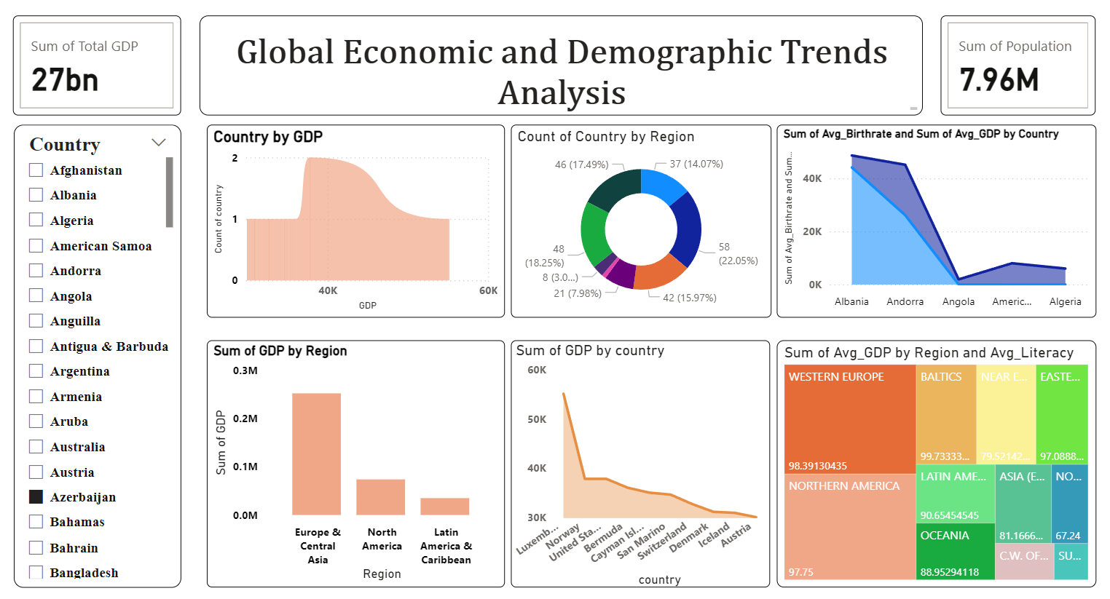
Dashboard :

Slide 7
Key Insights
Higher literacy correlates with higher GDP per capita.
GDP has significantly grown from 1960 to 2016 globally.
High-income countries lead in service sector contribution.
Recommendations
Invest in education to improve economic output
Diversify economies beyond agriculture
Regularly monitor development indicators

Slide 8
Conclusion
The project provides a data-driven view of global development.
Combines powerful tools to generate actionable insights.
Supports policy and investment decisions with evidence.

Slide 9
THANK YOU

